Slide 1

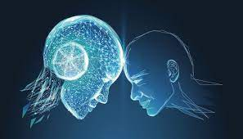


Module 3.6
Case Study: Does AI Make Better Decisions than People?
Living and Working with Artificial Intelligence
Developed for the AI4GA (Artificial Intelligence for Georgia) project funded by National Science Foundation awards DRL-2049029 and DRL-2048502.
This work is licensed under the Creative Commons. Attribution-NonComercial-ShareAlike 4.0 International License. https://creativecommons.org/licenses/by-nc-sa/4.0/

Slide 2
Teacher Notes
In this case study we have several options
Videos, Reflection, & Discussion
  Watch videos and answer questions.
  Followed by a class discussion.
Classroom debate
  Watch videos and read articles to prepare for debate arguments
  Each side gets to present their arguments in 3 rounds
  Setup -
    split the class into two groups pro or con, then split into 3 teams for each side
    Each team can identify an issue and build their argument for it.

Slide 3
Learning Objectives
Identify current uses of AI to make decisions and how it has impacted society or people
Evaluate the ways various stakeholders' values influence the design of an AI System
Identify and explain sources of bias in an AI system and decision making process
Explain how and why issues of bias, fairness, and transparency affect the design and use of AI systems and impacts on people
Create example laws, policies, and procedures that regulate the design and use of AI Systems that make decisions about people.

Slide 4
Case Study Option 1:
Videos, Reflection, Discussion

Slide 5
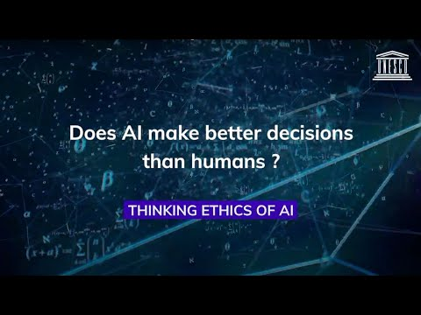
Does AI Make Better Decisions than People?
Video reflection
What are some of the benefits of using AI?
What are some of the disadvantages of using AI?
What kinds of decisions are AI making?
What are some of the concerns?
What are the sources of Bias in AI?
What is transparency and why is it important?
What are the limitations of AI?
What do you think?
Does AI Make Better Decisions than People?
Should AI be used to make decisions about people?
How should AI be used to make decisions about people?
https://www.youtube.com/watch?v=2E7l1hdjHsg
(5 mins, 33)
Notes:
Articles - https://www.vox.com/recode/2019/8/15/20806384/social-media-hate-speech-bias-black-african-american-facebook-twitter

Slide 6
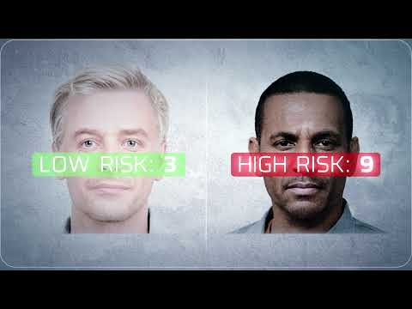
Accountable AI decision making: Human Rights and Technology 2021
What issues does this video raise about human rights?
What decisions are being made about people?
Who are using AI to make decisions about people?
What solutions are presented in this video to address the issues raised?
Who was this video produced by
https://www.youtube.com/watch?v=LZPBqTJd8ek (1 min 23 sec)

Slide 7
Discussion
Does AI Make Better Decisions than People?
What should we consider when using AI to make decisions about people?
What kinds of policies should we put in place to protect people while using AI?

Slide 8
Case Study Option 2 - Classroom Debate

Slide 9
Today, we are going to have a class debate on the topic:
Does AI Make Better Decisions than People?
We will split up into two groups and present arguments and evidence for each case:
Yes, AI makes better decisions than people…
Team 1 - Argument #1
Team 2 - Argument #2
Team 3 - Argument #3
No, AI does not makes better decisions than people….
Team 1 - Argument #1
Team 2 - Argument #2
Team 3 - Argument #3
Each group will be made up of 3 teams and together will present 3 arguments with evidence.

Slide 10
Debate Format
Does AI Make Better Decisions than People?
Each team will have 2 mins to present
We will have three rounds of debate and alternate between teams.
Round 1
Yes, AI makes better decisions than people…
Team 1 - Argument #1
No, AI does not makes better decisions than people….
Team 1 - Argument #1
Round 2
Yes, AI makes better decisions than people…
Team 2 - Argument #2
No, AI does not makes better decisions than people….
Team 2 - Argument #2
Round 3
Yes, AI makes better decisions than people…
Team 3 - Argument #3
No, AI does not makes better decisions than people….
Team 3 - Argument #3

Slide 11
We will use the following videos and article to help us prepare our cases
Things to consider when putting together your case:
Advantages or Disadvantages of using AI to make decisions
Types of decisions being made
How decisions are being made
Sources of data and potential biases in data or decision making
Concerns about using AI
Who is impacted by AI decisions
What are the Impacts on people
What kinds of things do we need to consider with using AI?
Should AI be used independently or with people?
Who is using AI to make decisions?
Human Rights that need to be protected

Slide 12
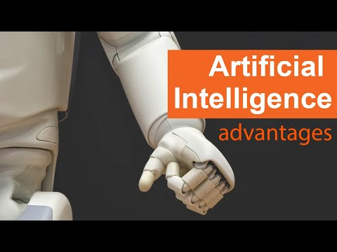
Advantages of Artificial Intelligence
https://youtu.be/QfY3AhKmB3c (2 min 25 sec)

Slide 13
Does AI Make Better Decisions than People?
https://www.youtube.com/watch?v=2E7l1hdjHsg
(5 mins, 33)

Slide 14
Accountable AI decision making: Human Rights and Technology 2021
https://www.youtube.com/watch?v=LZPBqTJd8ek (1 min 23 sec)
High-level summary report

Slide 15
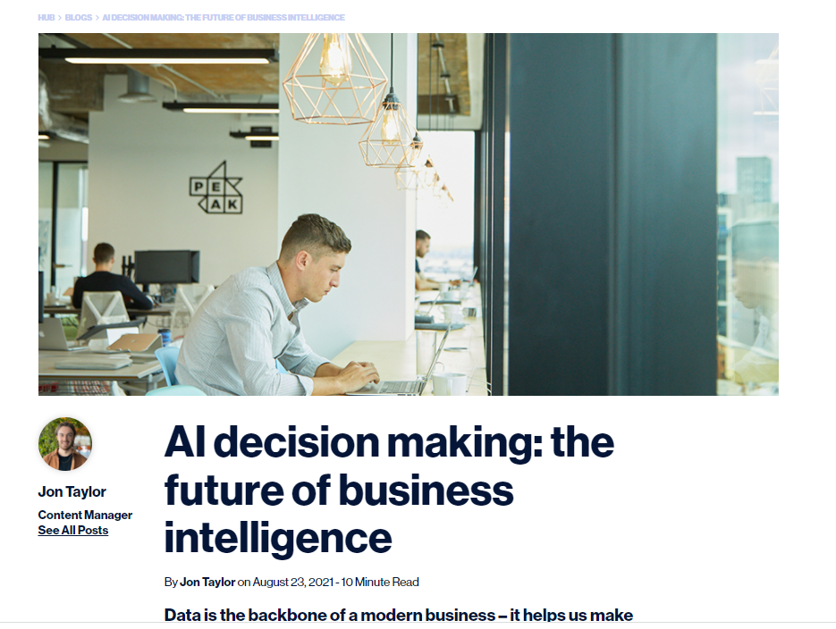
AI Decision making: the future of business intelligence
Article - https://peak.ai/hub/blog/ai-decision-making-the-future-of-business-intelligence/

Slide 16
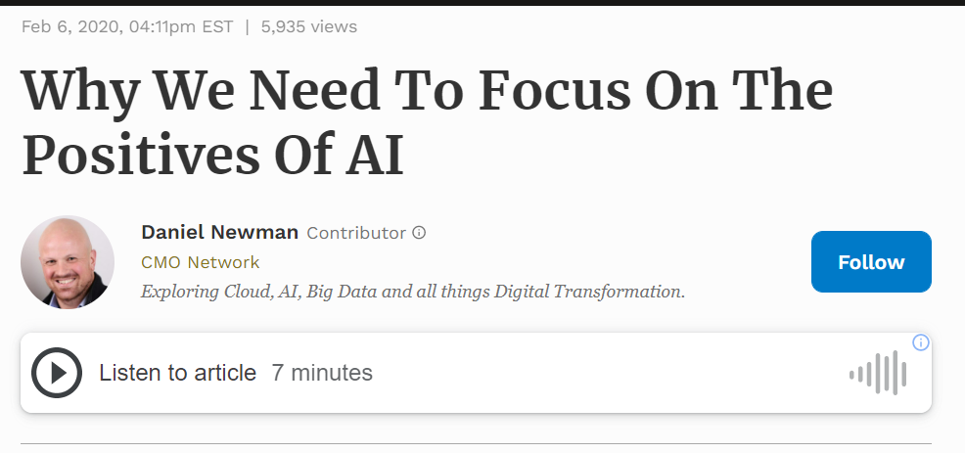
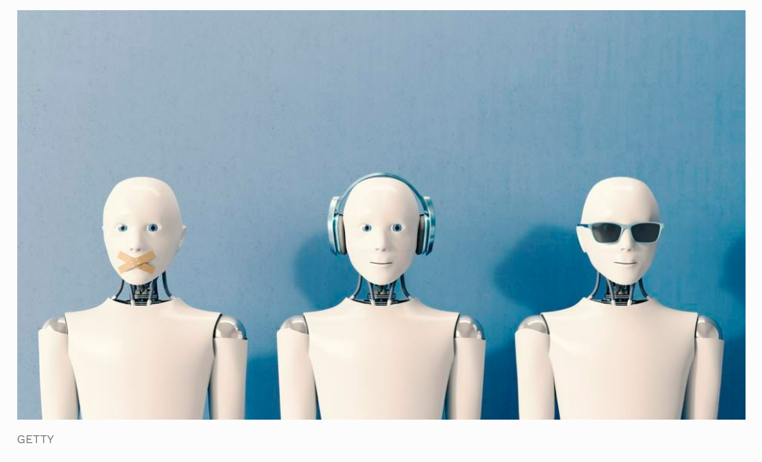
Why we focus on the positives of AI
https://www.forbes.com/sites/danielnewman/2020/02/06/why-we-need-to-focus-on-the-positives-of-ai/?sh=40603ce775ae

Slide 17
The following two pages may help structure or scaffold how teams in defining their arguments.
Use only if they are helpful or
reformat in whatever ways best serve your students.

Slide 18
Yes, AI makes better decisions than people because
AI solves problem __________________
Benefit ______________________
Who this solution benefits ____________________
Examples or other evidence to consider:

Slide 19
No, AI does not make better decisions than people because
AI solves problem __________________
Use of AI decision making causes problem __________________
Disadvantage______________________
Who this solution disadvantages ____________________
Examples or other evidence to consider:

Slide 20
Does AI Make Better Decisions than People?
Each team will have 2 mins to present
We will have three rounds of debate and alternate between teams.
Round 1
Yes, AI makes better decisions than people…
Team 1 ______________ Argument #1
No, AI does not makes better decisions than people….
Team 1______________ - Argument #1
Round 2
Yes, AI makes better decisions than people…
Team 2 ______________ - Argument #2
No, AI does not makes better decisions than people….
Team 2 ______________ - Argument #2
Round 3
Yes, AI makes better decisions than people…
Team 3 ______________ - Argument #3
No, AI does not makes better decisions than people….
Team 3 ______________ - Argument #3

Slide 21
Ticket out the Door
Does AI Make Better Decisions than People?
What is your answer to this question?

Slide 22
Partial Answers for teachers
AI is is faster than humans (pro)
Positive and Negative Ways AI can be used
  Medical
  Policing and judicial/courtroom sentencing
  Hate speech detection
  Credit ratings
  Discrimination
  Important decisions
  Doctors making diagnosis with AI
    Using AI/ML trained to interpret medical imaging and detect cancer (positive)
    Used in conjunction with humans
    Too uniform - different opinions about how to proceed is ok. But Uses of AI may limit the diversity of approaches to treating a disease (con)

Slide 23
Partial Answers for teachers
Positive and Negative Ways AI can be used(cont.)
  Can be biased
    Datasets could be bias
    Collected in certain areas than others -> high crime areas -> bias against certain groups -> certain groups are seen to commit more
    Bias in systems reflect the bias already existing in society
    There is racial bias in language understanding
  Use of AI in Policing and sentencing
    Determining who is more likely to commit a crime
      Collected in certain areas than others -> high crime areas
    Judges coming to verdict with the use of AI (positive/negative)
      Collected in certain areas than others -> high crime areas
      Likelihodd to reaffend (missing)
    Social injustice -> we could be feeding AI with data that is already biased -> not making better decisions
  Use AI to solve hate speech
    Issues hate speech isn’t well defined or agreed upon. It depends on context
    It is a complete problem of human nature
    AI isn’t good at
    AI doesn’t understand sadness or
    AI understand certain types of language better than others
    English of a dialect vs good english - Have views censored or social media accounts banned
Don’t know how AI makes decisions
  AI makes decisions which are too uniform (negative)
Need to understand the limitations of systems
  If we are not critical of AI we could be perpetuate existing bias

Slide 24
Partial Answers for teachers
Positive and Negative Ways AI can be used(cont.)
  Use AI to solve hate speech
    Issues hate speech isn’t well defined or agreed upon. It depends on context
    It is a complete problem of human nature
    AI isn’t good at
    AI doesn’t understand sadness or
    AI understand certain types of language better than others
    English of a dialect vs good english - Have views censored or social media accounts banned
Don’t know how AI makes decisions
  AI makes decisions which are too uniform (negative)
Need to understand the limitations of systems
  If we are not critical of AI we could be perpetuate existing bias

